Slide 1

E-Learning
Presented by:
Niyati rattan
Nitin garg
Namandeep singh
Parivesh Mehta
himani

Slide 2

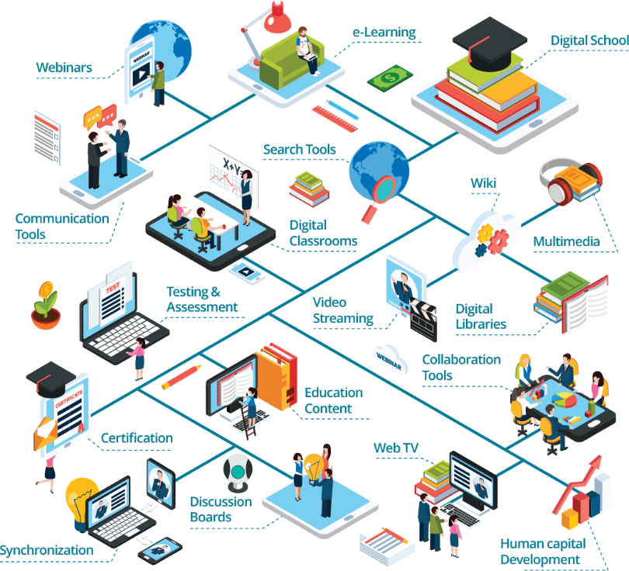
TOC
.
01
Problem Statement
02
Our Solution
03
E-Learning Approaches
.
04
Advantages of E-Learning

Slide 3

making learning, amazing e – learning
Transforming learning into
amazing E – Learning .
Problem Statement:
Online learning has shown significant growth over the last decade, as the internet and education combine to provide people with the opportunity to gain new skills. Since the COVID-19 outbreak, online learning has become more centric in people's lives. The pandemic has forced schools, universities, and companies to remote working and this booms the usage of online learning. Even before the pandemic, Research and Markets forecast the online education market as $350 Billion by 2025, so the numbers might be updated after analyzing the growth impacts

Slide 4

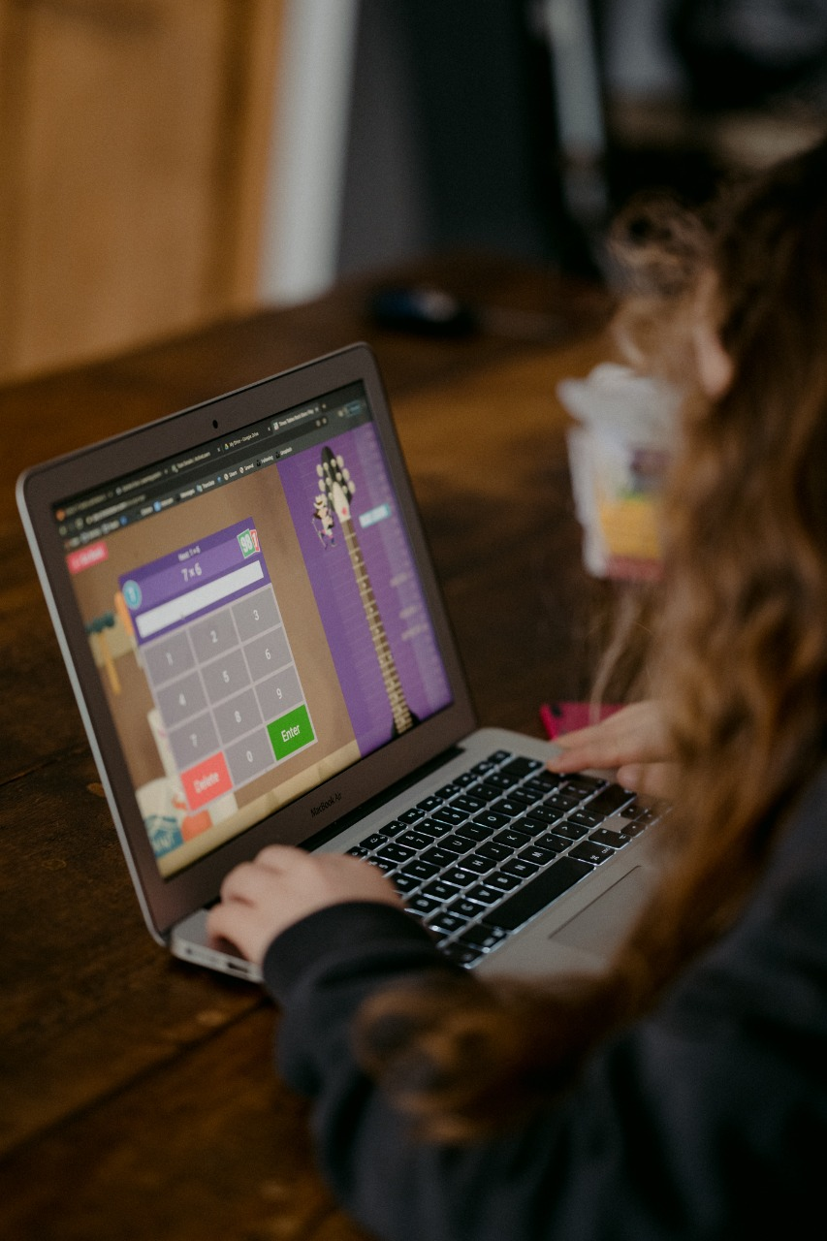
our solution
Add Questions and Quizzes
We can make e-learning much better by giving questions to learners and solving their doubts.
We can add a variety of questions in our eLearning. This can serve multiple purposes:
Allows learners to test and validate their own knowledge
Allows the learner to reflect on the content and how they would apply the knowledge in real life
Another form of interactivity to get learners physically doing stuff with the screen can allow us to test their understanding and compliance
Questions can be of 2 types :
Quiz
Knowledge Check
Instead of giving multiple choice questions we can give
other type of questions such as drag and drop box,
hotspot, Likert Scale and more
In this way we can make e learning better and
interesting.

Slide 5

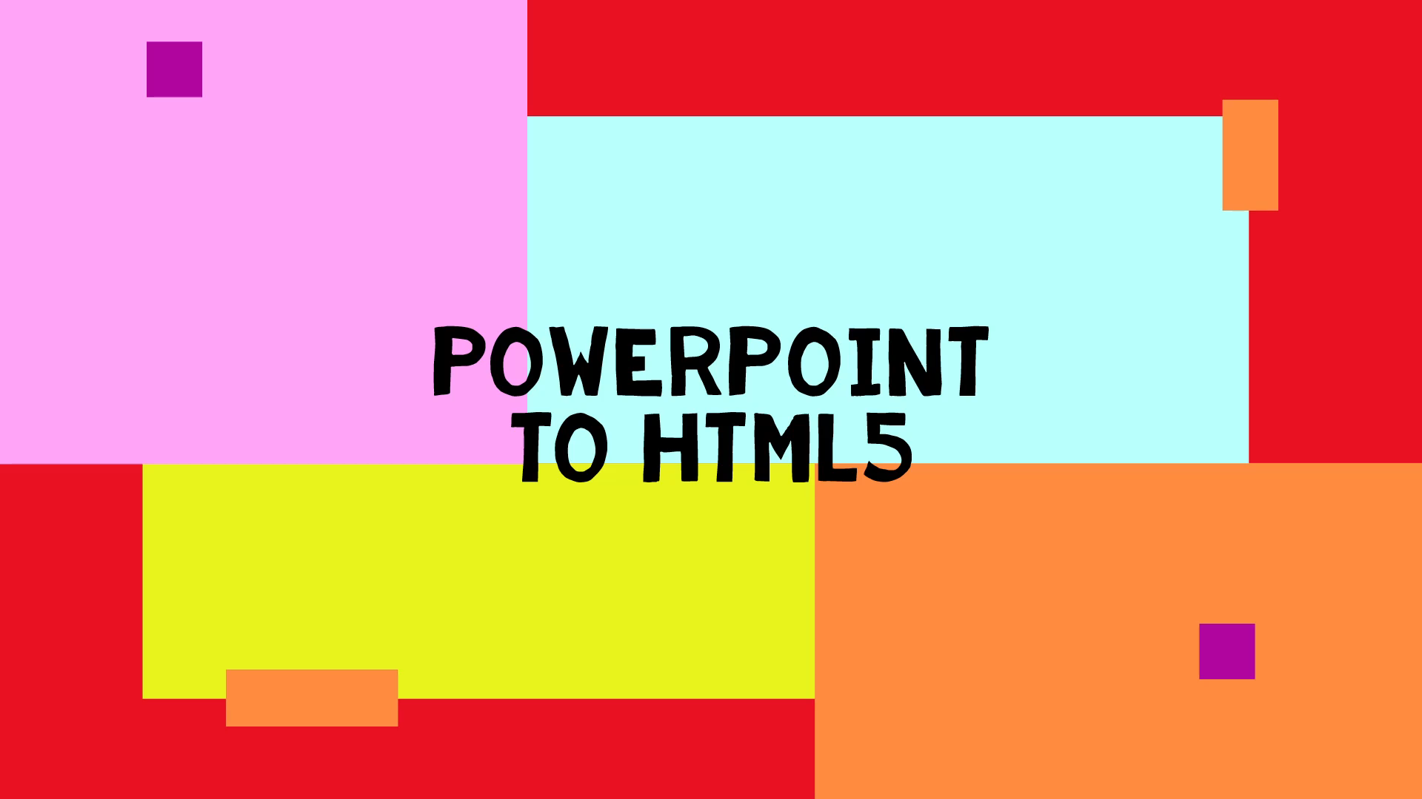
our solution
Convert Your PowerPoint Slides To HTML5
Our first example is to convert your PowerPoint presentation into an HTML5 file using a tool like iSpring. You are able to create powerful and engaging slides in PowerPoint that can contain video, audio files, and animations. With the additional power of a tool like iSpring, you can rapidly turn your PowerPoint slides into eLearning. As an HTML5 file, learners can navigate through your stunning presentation on their web browser on PC or on their mobile devices.
There’s a lot more to creating engaging eLearning that captivates your audience and actually teaches something, but this is a good first step to get you moving in the right direction. This technique can be really effective if you take some extra time to make you slides fun and interesting.
https://youtu.be/a1dQSbyuPuk

Slide 6

E-learning is a good option when…
there is a significant amount of content to be delivered to a large number of learners,
learners come from geographically dispersed locations.
earners have limited mobility
learners have limited daily time to devote to learning;
learners do not have effective listening and reading skills;
learners have at least basic computer and Internet skills
learners are required to develop homogeneous background knowledge on the topic
earners are highly motivated to learn and appreciate proceeding at their own pace
content must be reused for different learners’ groups in the future
.

Slide 7
E-learning approaches
There are two general approaches to e-learning: self-paced and facilitated/instructor-led.
Self-paced learners are alone and completely independent, while facilitated and instructor-led e-learning courses provide different levels of support from tutors and instructors and collaboration among learners. Often, e-learning courses combine both approaches, but for simplicity it is easy to consider the two separately.
Self-paced e-learning Learners are free to learn at their own pace and to define personal learning paths based on their individual needs and interests. E-learning providers do not have to schedule, manage or track learners through a process E-learning content is developed according to a set of learning objectives and is delivered using different media elements, such as text, graphics, audio and video. It must provide as much learning support as possible in order to make learners self-sufficient. However, some kind of support, such as e-mail-based technical support or e-tutoring, is normally offered to learners. | Instructor-led and facilitated e-learning The course is scheduled and led by an instructor and/ or facilitator through an online learning platform. E-learning content for individual study can be integrated with instructor’s lectures, individual assignments and collaborative activities among learners. Learners, facilitators and instructors can use communication tools such as e-mails, discussion forums, chats, polls, whiteboards, application sharing and audio and video conferencing to communicate and work together.

Slide 8
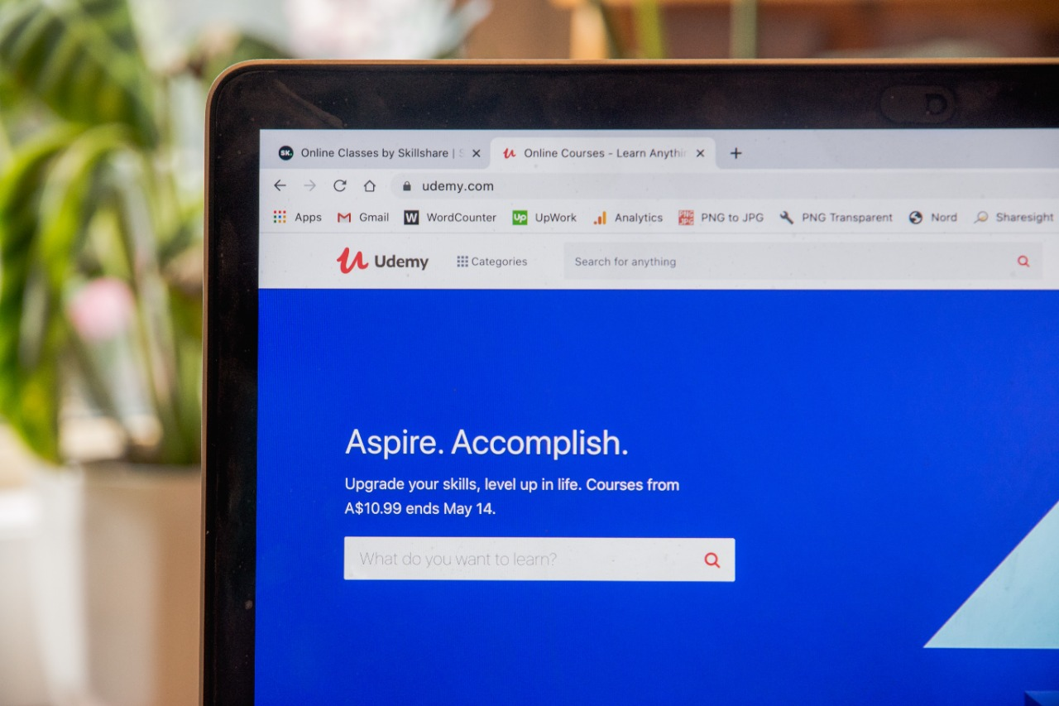
Advantages of e-learning
Convenience :- The fact that you can have access to courses anywhere and anytime is one of the biggest advantage of e-learning. The courses can be accessed from smartphones, desktop, or tablet from a train, plane, or a hotel. You can also refer to them whenever you have a doubt or question
Cost-effective:- They are truly easy on your pocket. By being online, these courses can help save on a huge amount of printing costs. In fact, compared to traditional learning, e-learning is found to be 50-70% cheaper.
Productivity:-E-learning courses are a great way to increase the productivity of employees, since they help you stay updated on the current industry processes. Since they’re easily accessible, they can be helpful for all employees freshers and veterans. Moreover, you don’t encroach on your work-time to finish these because they can be completed at any point in time.
Technologically-advanced:-21st-century businesses are technologically advanced and comprise advanced processes and functions. Thus the training component in these businesses should also be fast and advanced. Most employees are active on smartphones, laptops, and cloud services. E-learning helps bring training to these platforms from desks and classrooms. Leveraging these technologies to offer training to employees helps save time, cost, and increases the convenience of learning

Slide 9

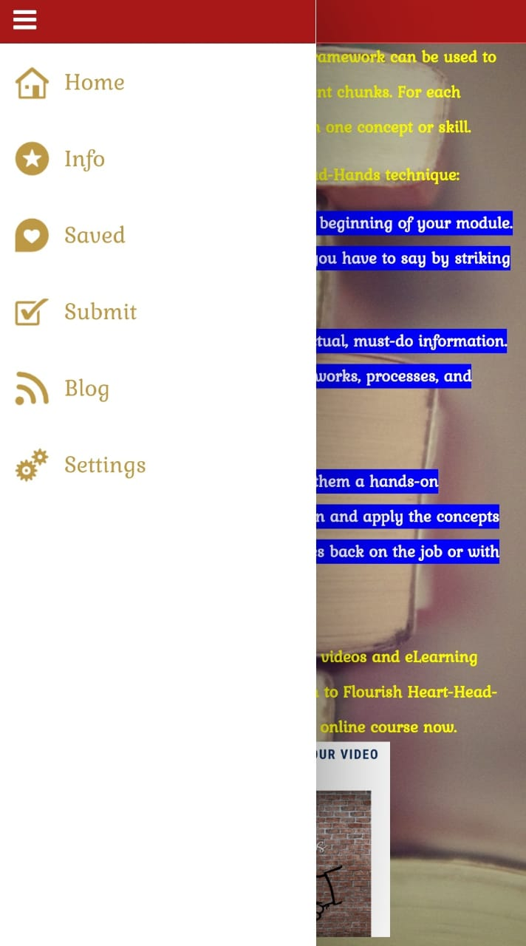
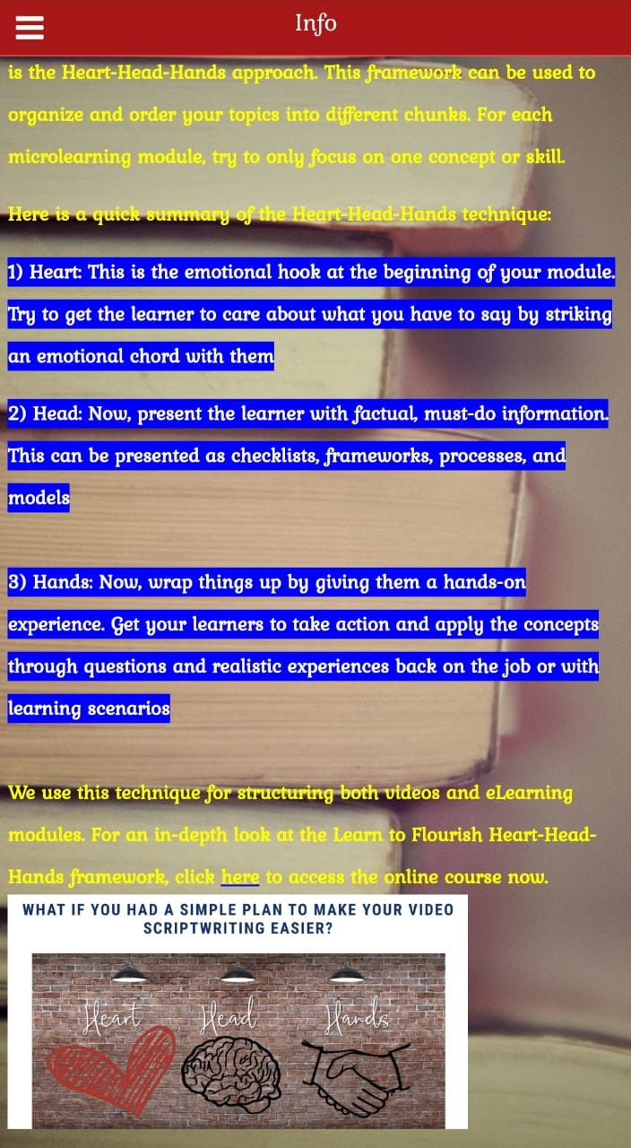
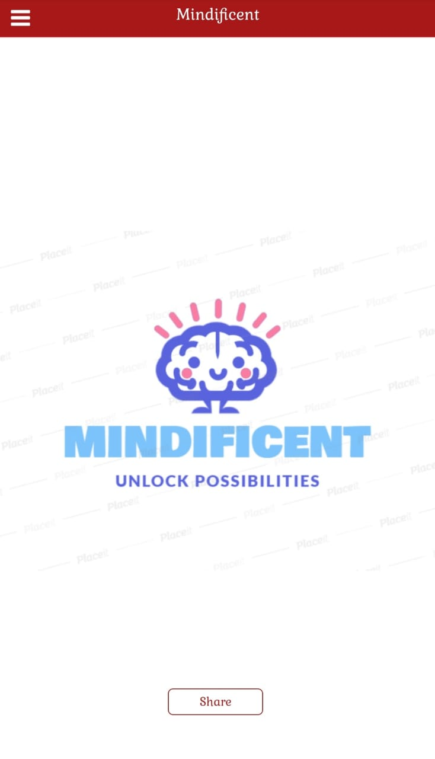
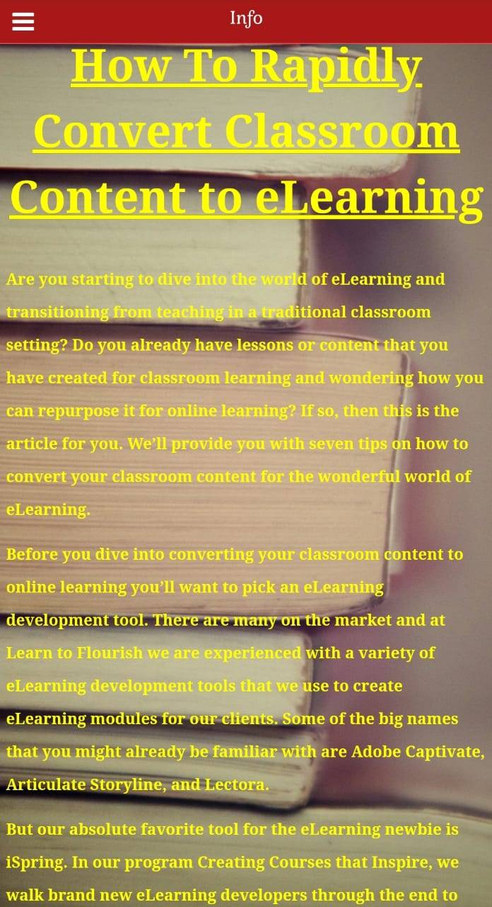
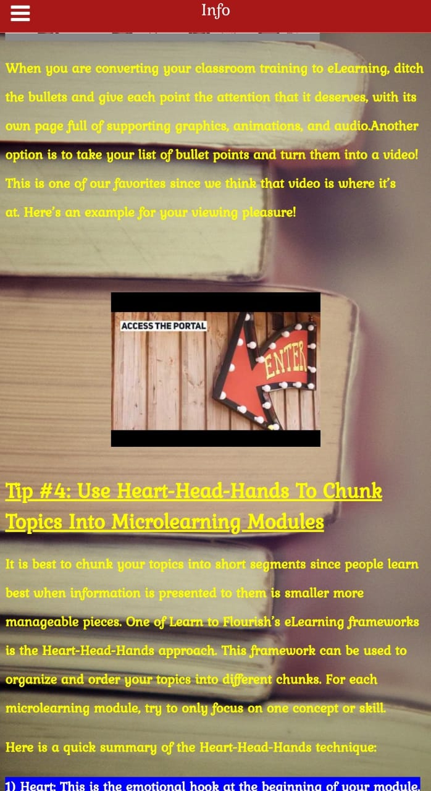
MINDIFICENT-our prototype
Mobile apps for educational institutions have done a great thing for the students, making the learning process fun and easy. Also, the various app features boost engagement through knowledge-oriented activities. In these changing times, students are more driven towards using a mobile phone for every purpose. A smartphone they call it. The world is at the fingertips and a student can get access to any information from anywhere. This reduces the chance of visiting a library and searching for the data. A mobile phone hence can be used for a number of such purposes. What makes the information easily available is mobile applications. Every mobile app has a unique feature which offers its own set of services. Mindificent is designed with the motive of helping students to get every information required for their academic as well extra information in a manner that the students

Slide 10

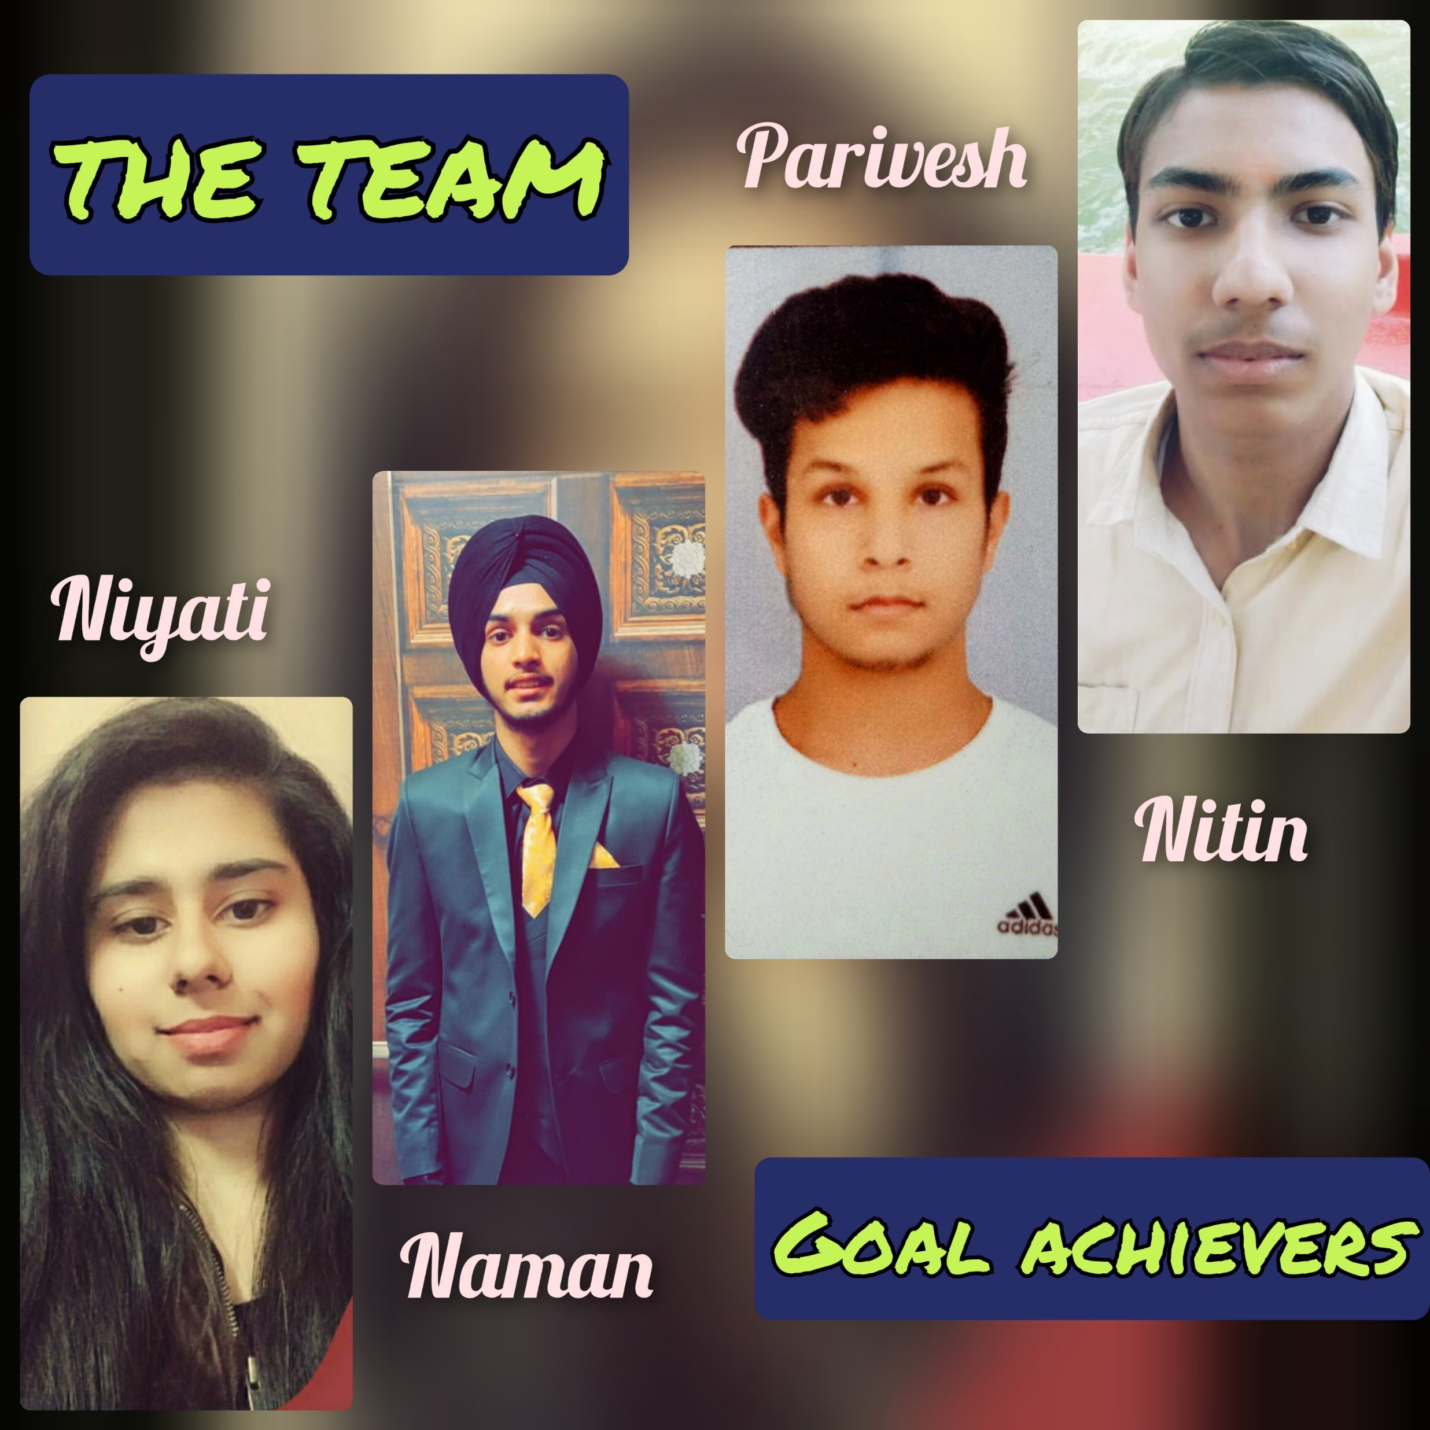


Slide 11
“Learning is changing, And we will see new models, new technologies and design emerges, so let’s drop the “e”- or at least give it a new and wider definition.”
THANK YOU

